Slide 1

Netquest
Sprint A

Slide 2
Product Vision
Why?
What?
The app allows users to search for and mark zones where free Wi-Fi is available. While using the app, you can confirm the availability of Wi-Fi at specific locations. It’s a community-driven initiative to map and share the best Wi-Fi spots across the city.
How?
User-driven Mapping
Confirmation and Rewards
Point System
Interactive Map
Search Filters
Tired of working or studying from home? Why not use the NetQuest Application in order to locate free Wi-Fi spots in your city. Wheter you want a change of scenary or just want to work in café, it will help you find the perfect spot.
AI Suggestions

Slide 3
User Personas
Persona 1: The Regular User (Remote Worker / Student / Digital Nomad / Casual User)
Name: Jamie Nguyen Age: 29 Occupation: Freelance Graphic Designer / Digital Nomad

Slide 4

Persona 1: The Regular User (Remote Worker / Student / Digital Nomad / Casual User)
Motivations
To find convenient, high-quality Wi-Fi locations that support remote work, studies, or leisure without disruptions.
To discover new spots based on personal preferences, such as quieter environments with reliable Wi-Fi.
To take advantage of point-based rewards and discounts as a part of the app's social and financial perks.
Goals
Locate Wi-Fi spots that are rated highly by other users for connectivity and environment.
Earn points by engaging with the app, which can be redeemed for discounts or benefits at partner establishments.
Access AI-driven suggestions to simplify the search for ideal locations based on preferences and past activity.

Slide 5
Persona 1: The Regular User (Remote Worker / Student / Digital Nomad / Casual User)
Pain Points
Inconsistent Wi-Fi quality, especially in busy or unfamiliar locations.
Lack of information about crowd levels or the atmosphere of locations.
Difficulty balancing connectivity with a comfortable, distraction-free environment.
Lack of human interaction and mobility, such as walking and not staying in the same place all day.
How the App Helps
Customizable Search: Jamie can input specific preferences (e.g., “quiet location with fast Wi-Fi”) and receive a filtered list of options that match.
AI Suggestions: AI analyses Jamie’s activity and preferences, recommending times and spots that align with work-friendly settings.
Points and Rewards: Jamie can earn points for finding and reviewing locations, which can then be redeemed at premium partner spots, creating value for consistent usage.
Takes you outside. By giving suggested locations with high quality Wi-Fi based on his goal, Jamie now can leave home, do his work, have human interaction outside and walk/drive to get to know undiscovered places of the city.

Slide 6
User Personas
Persona 2: The Premium Establishment (Verified Partner Location)
Name: Alex Patel Age: 45 Occupation: Owner of Coffee Shop Chain

Slide 7

Persona 2: The Premium Establishment (Verified Partner Location)
Motivations
To increase foot traffic from remote workers and digital nomads seeking reliable Wi-Fi.
To distinguish the coffee shops as verified and preferred locations on the app for enhanced visibility.
To foster loyalty and recurring visits through exclusive discounts available via the app.
Goals
Enhance the coffee shop’s brand presence on the app as a verified, premium Wi-Fi location.
Offer unique discounts or promotions (e.g., 20% off on select items) that can be redeemed through user points to attract loyal customers.
Utilize the app’s user analytics and traffic data to optimize store hours, staffing, and customer service.

Slide 8
Persona 2: The Premium Establishment (Verified Partner Location)
Pain Points
Managing peak times when Wi-Fi usage is high and ensuring a positive experience despite crowding.
Competing with other coffee shops and coworking spaces in busy areas.
Balancing promotional efforts with the goal of building long-term customer loyalty.
How the App Helps
Verified Premium Status: Alex’s coffee shops appear prominently on the app, attracting users seeking trusted, high-quality Wi-Fi.
Point-Driven Discounts: The app enables Alex to create redeemable discounts (e.g., 20% off a purchase with enough points), boosting loyalty and encouraging repeat visits.
Foot Traffic Insights: Alex can view user patterns and preferences to adjust operational hours or promotions, creating an optimized experience for visitors.

Slide 9
General workflow
User Opens App: Sees a map with free Wi-Fi locations nearby.
User Filters Results: Chooses filters like indoor/outdoor, rating, connection quality, or AI suggestions.
User Contributes: Adds a new Wi-Fi location or confirms an existing one, earning points for contributions.
User Redeems Points: Users can track points earned and redeem them for rewards like mobile data.

Slide 10
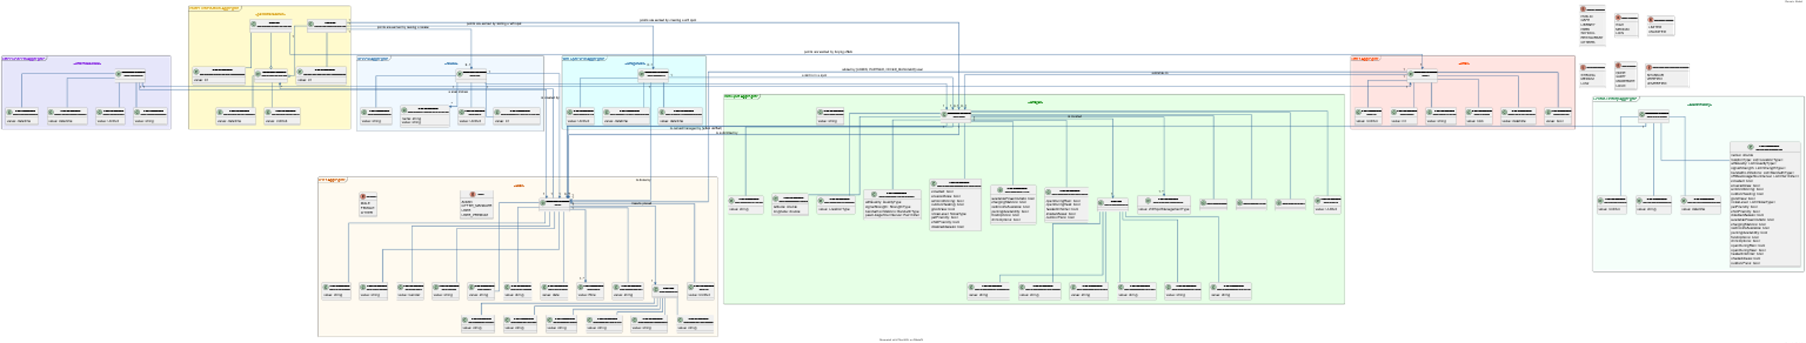
Domain Model

Slide 11
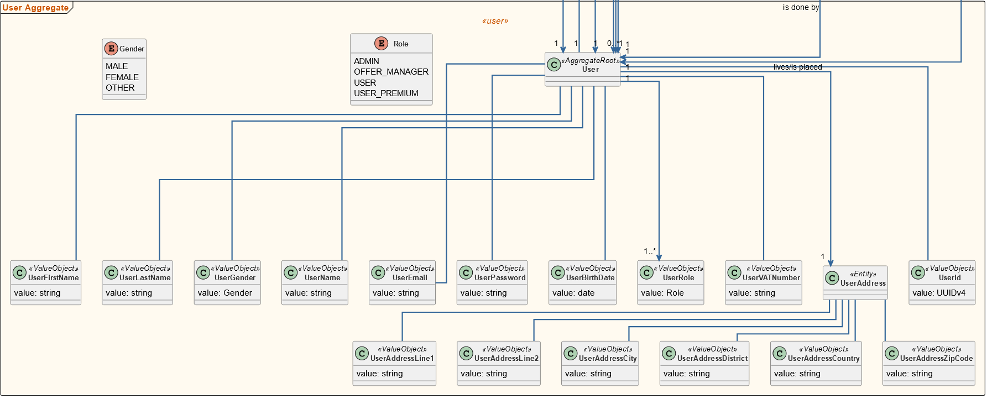
Domain Model - User

Slide 12
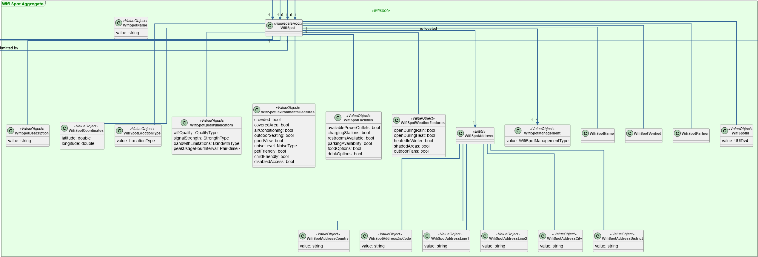
Domain Model – wifi spot

Slide 13
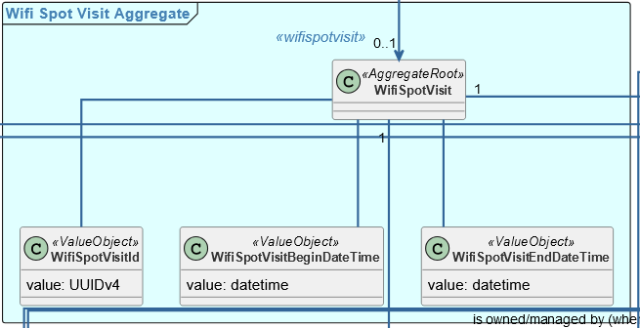
Domain Model – WIFI SPOT VISIT

Slide 14
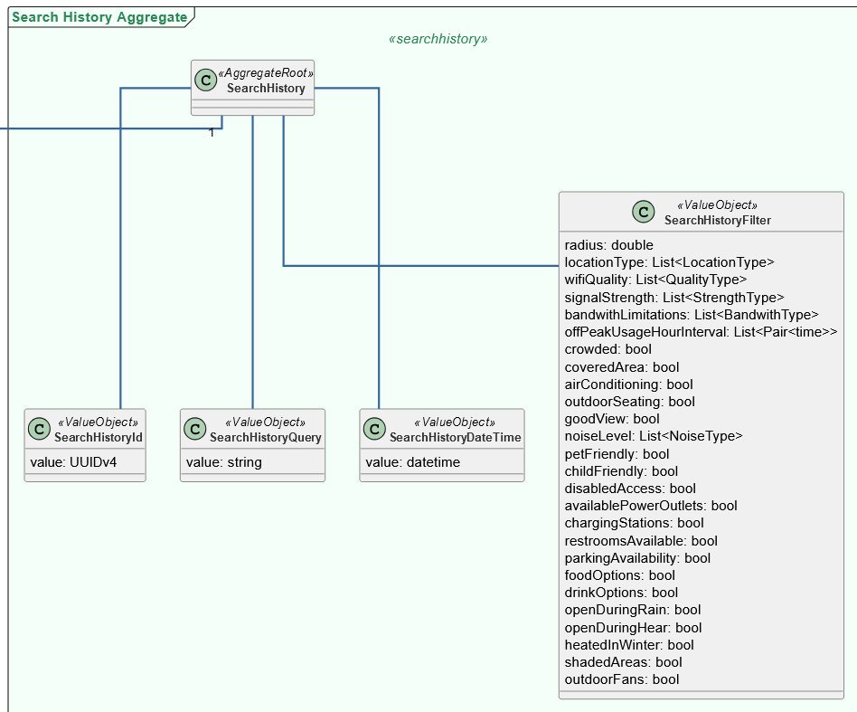
Domain Model – Search history

Slide 15
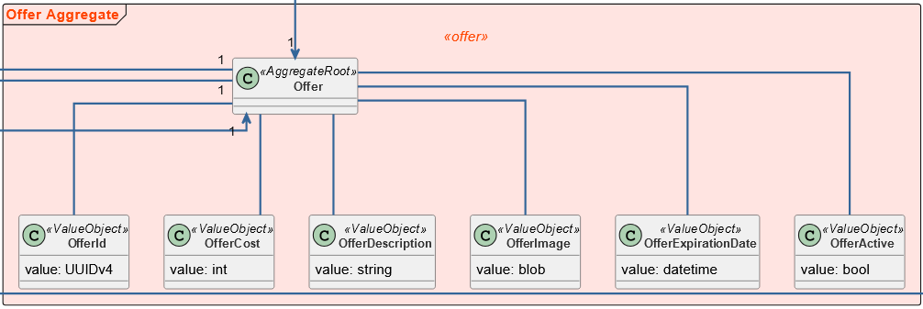
Domain Model - OFFER

Slide 16
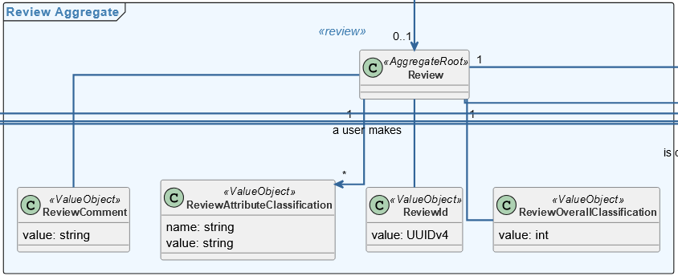
Domain Model - review

Slide 17
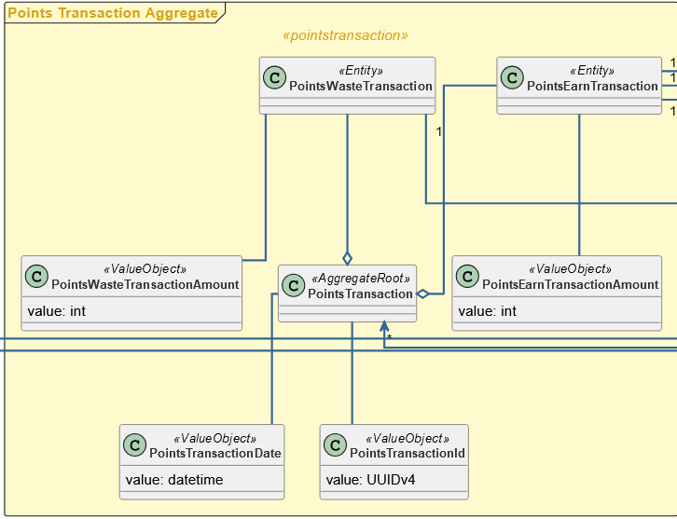
Domain Model – points transaction

Slide 18
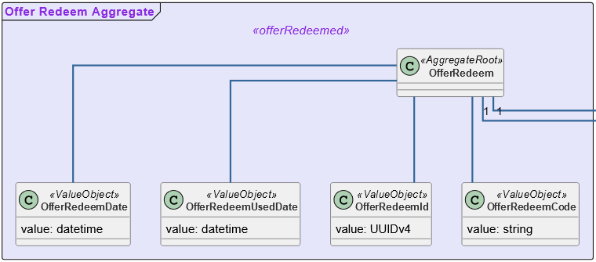
Domain Model – offer redeem

Slide 19


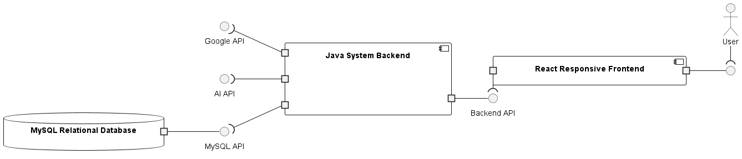
Architecture & technology

Slide 20
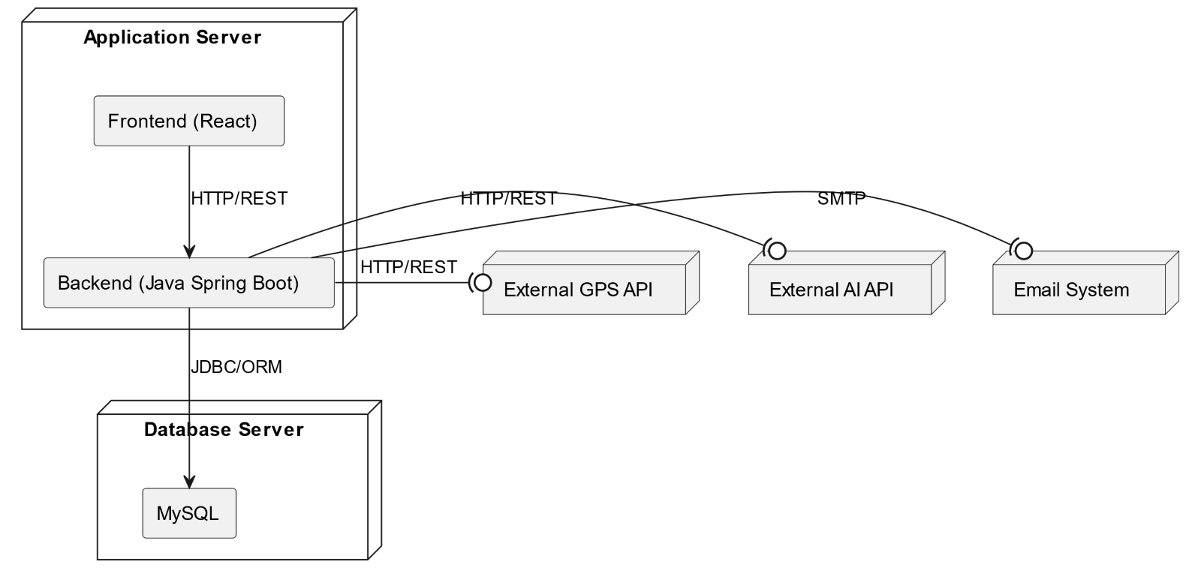
Architecture & technology

Slide 21
Assumptions and dependencies
Users have access to internet connection
1
Users have location services enabled on their devices, allowing the app to accurately determine their current location.
2
Users are likely to have at least one navigation app (Google Maps or Waze) installed on their devices for the redirection feature to work.
3
Users are familiar with basic smartphone functionalities, including how to interact with maps and navigation apps.
4
Users are motivated to find and use Wi-Fi locations for personal or professional needs, such as studying, working, or socializing.
5
Users are aware of their surroundings and use common sense while navigating to new locations, particularly in unfamiliar areas.
6
Users may have varying levels of accessibility needs, and the app should consider features to accommodate those needs.
7

Slide 22
Operating costs estimation
Category | Low Estimate (€) | High Estimate (€)
Hardware (monthly) | €150/month | €600/month
Software (monthly) | €600/month | €650/month
Salaries (annual) | €380,000/year | €490,000/year
Cloud Infrastructure (monthly) | €500/month | €1,500/month
Marketing (monthly) | €1,000/month | €3,000/month
Miscellaneous (annual) | €5,000/year | €10,000/year
Laptops and peripherals (every 4 year) | €8,000/4 year | €30,000/4 year
Total (annual) | €414,000/year | €676,500/year

Slide 23
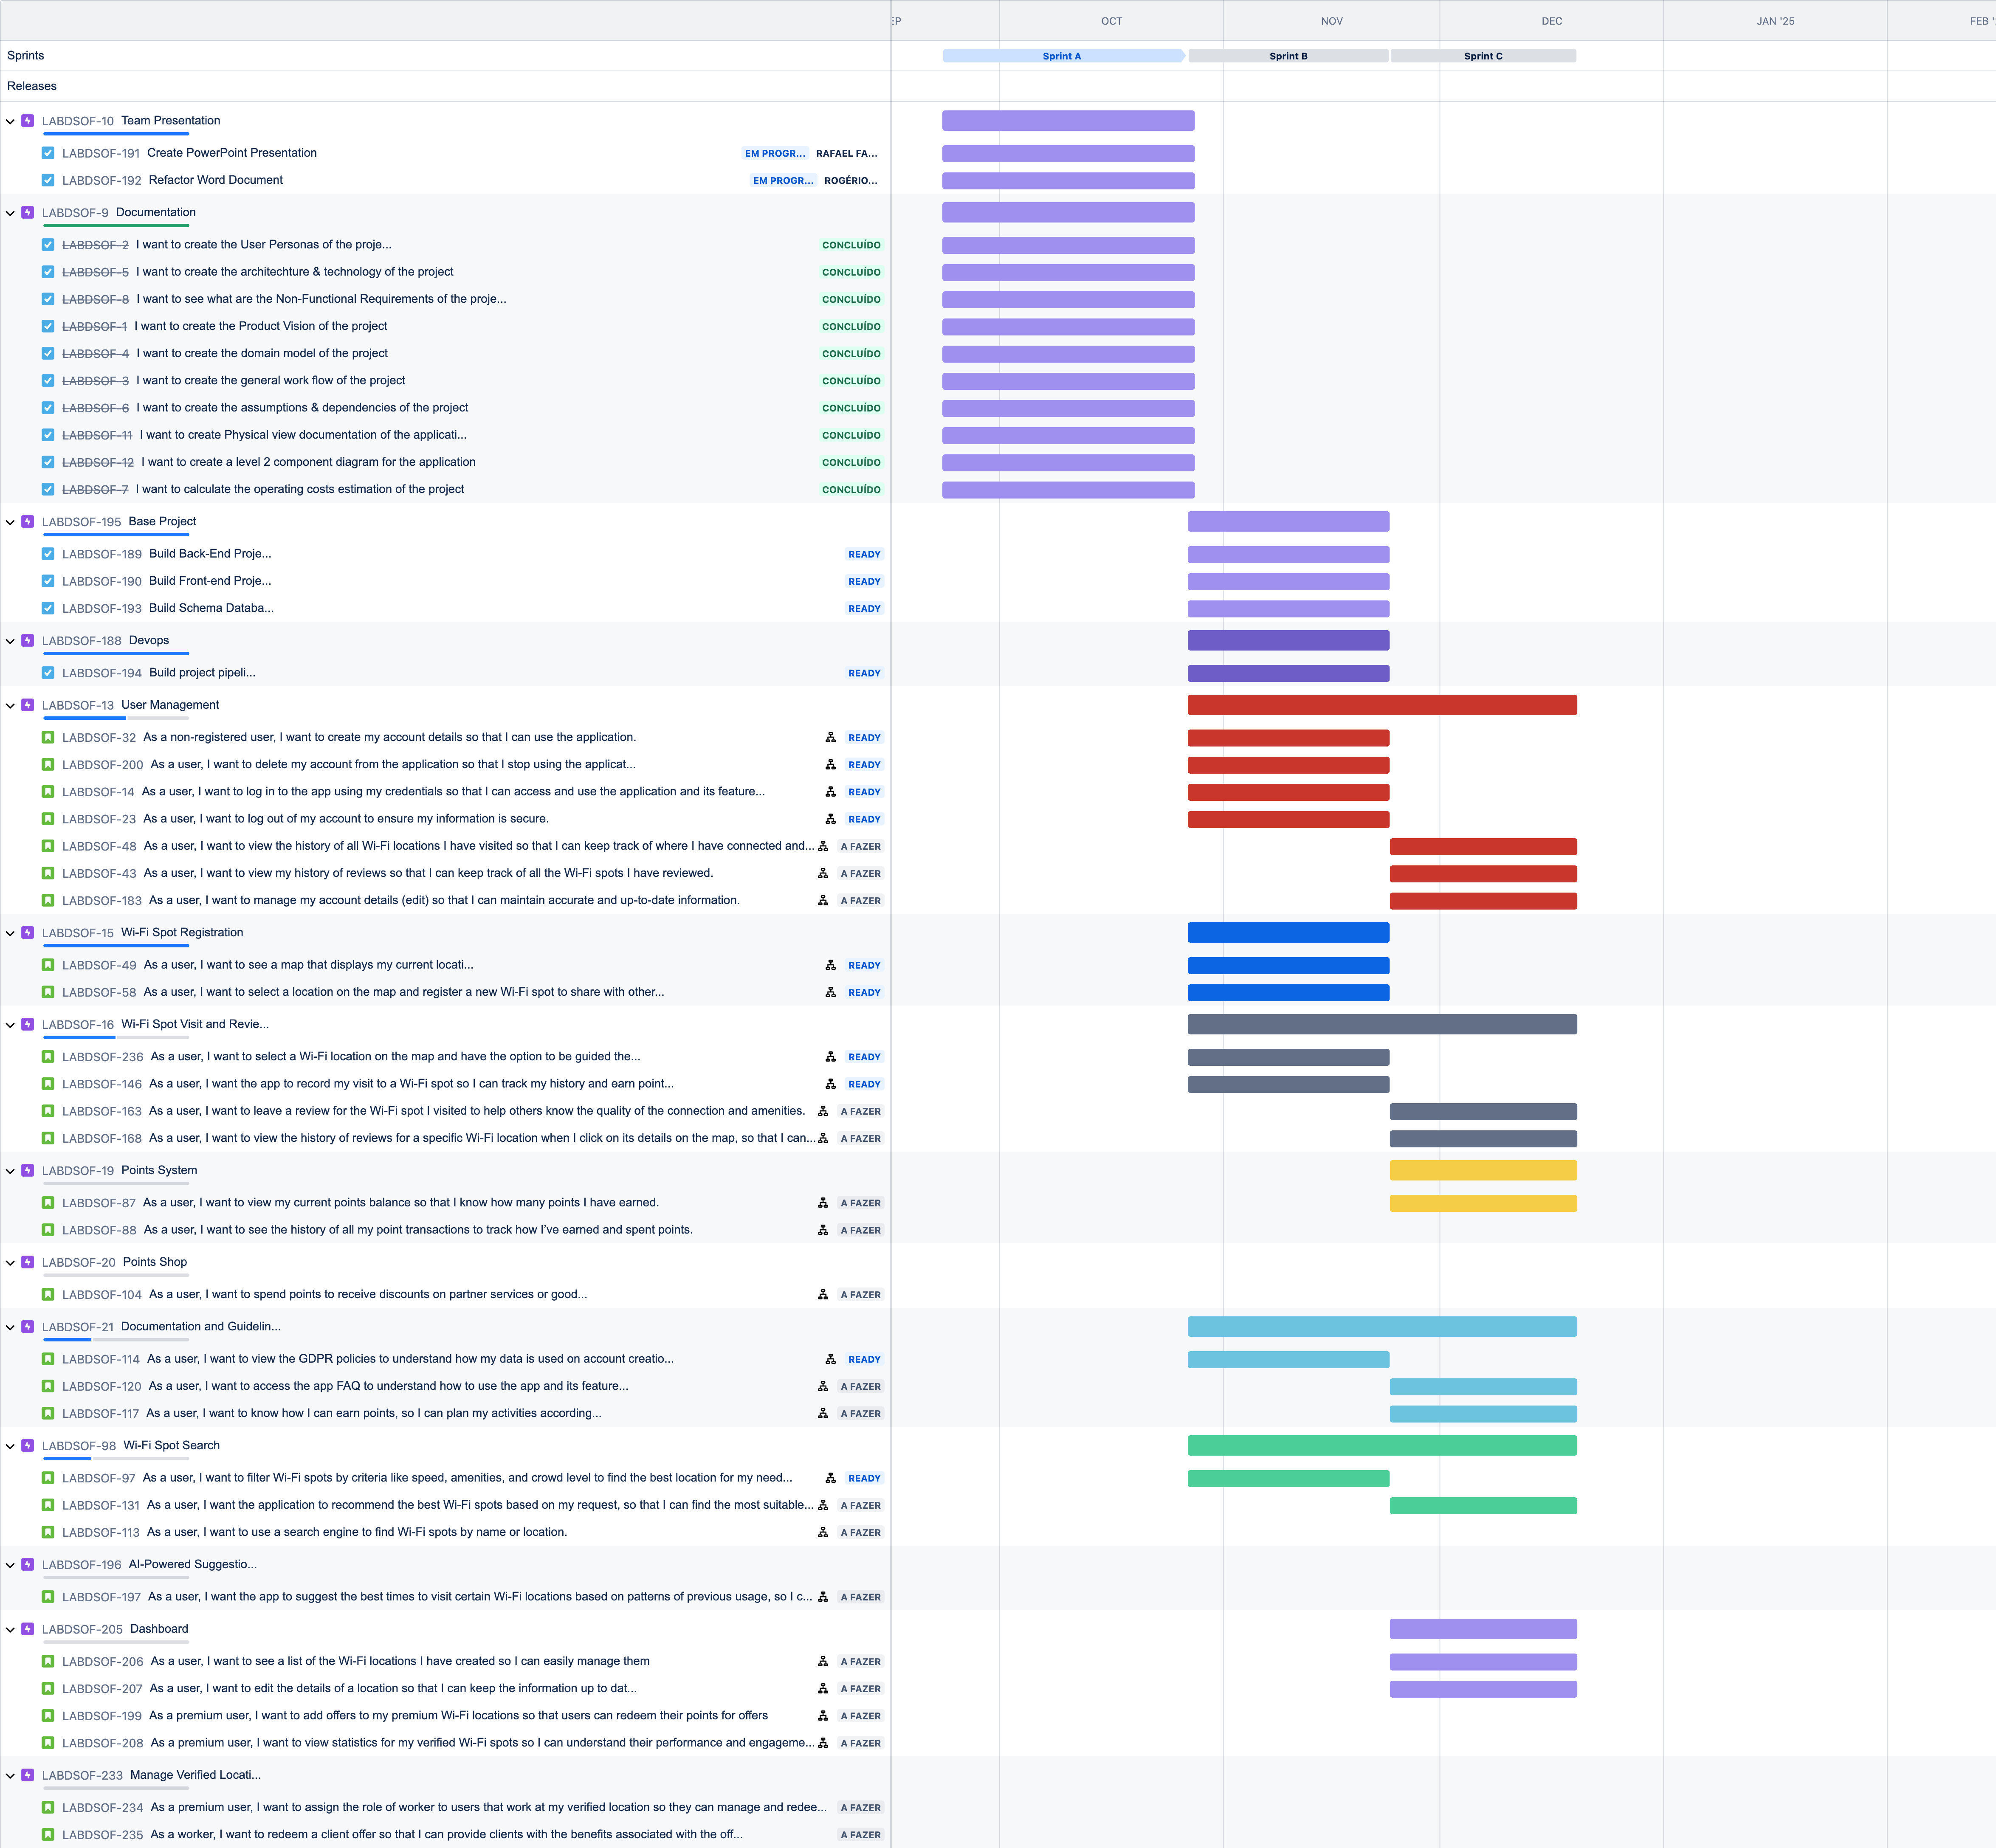
Prioritized product backlog

Slide 24
Non-Functional Requirements
Scalability: The app should support many users and Wi-Fi spot data across multiple cities without performance degradation.
Performance: The app should load and display nearby Wi-Fi spots on a map within 3 seconds of opening.
Security: The app should encrypt all personal user data and use secure connections (HTTPS) for all communications.
Availability: The app should have 99.9% uptime, always ensuring reliable access to Wi-Fi spot data.
Usability: The app should be intuitive, with a user-friendly interface, ensuring users can easily find Wi-Fi spots and contribute without needing a tutorial.
Responsiveness: The app should function smoothly on a variety of devices (smartphones, tablets).

Slide 25
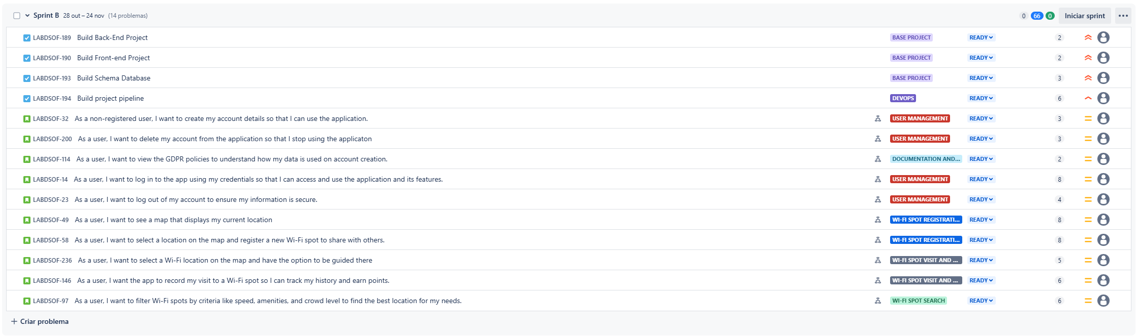
High level scope sprint 1

Slide 26
People and responsibilities
PRODUCT MANAGER - Ensure that the app delivers value to users and meets business goals.
BUSINESS ANALYST - Bridge the gap between business objectives and technical development, ensuring clarity in requirements.
UI/UX DESIGNER - Design intuitive and visually appealing interfaces that cater to users' needs.
DEVELOPERS - Design intuitive and visually appealing interfaces that cater to users' needs.
AI SPECIALIST - Design and implement AI-driven features that enhance the user experience, such as personalized suggestions and weather-based filtering.
QUALITY ASSURANCE - Ensure the app is free of bugs, performs well, and provides a smooth user experience.
DEVOPS ENGINEER - Set up continuous integration and continuous deployment pipelines to automate testing and deployment.
MARKETING MANAGER - Drive user acquisition, retention, and growth, ensuring the app reaches the right audience.
CUSTOMER SUPPORT - Ensure users are supported and their concerns are addressed, creating a positive user experience

Slide 27

People and responsibilities – Collaboration overview
PM and BA work closely to define requirements and features.
Designers collaborate with PM and UX/UI to create user-centred designs.
Developers work with QA to ensure a smooth development process with frequent testing.
DevOps ensures the app runs smoothly in production.
Marketing and Customer Support ensure the app is well-received and users are engaged.
This team structure ensures all aspects of the project, from development to user experience and growth, are well-handled.

Slide 28
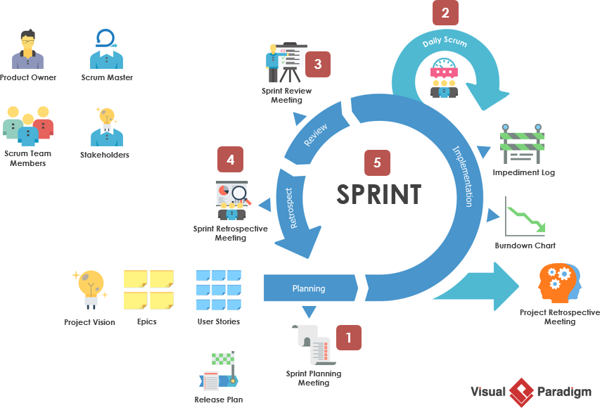
Work methodology
Scrum
Sprint Events (Retrospective, Demo, Backlog Refinement)

Slide 29
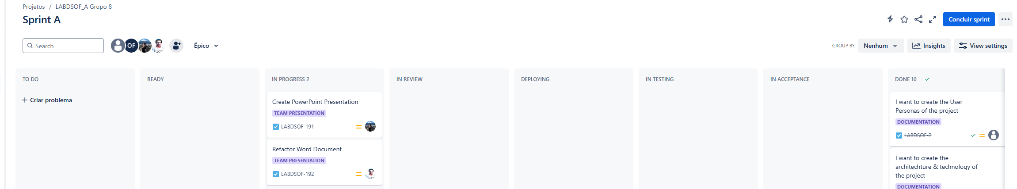
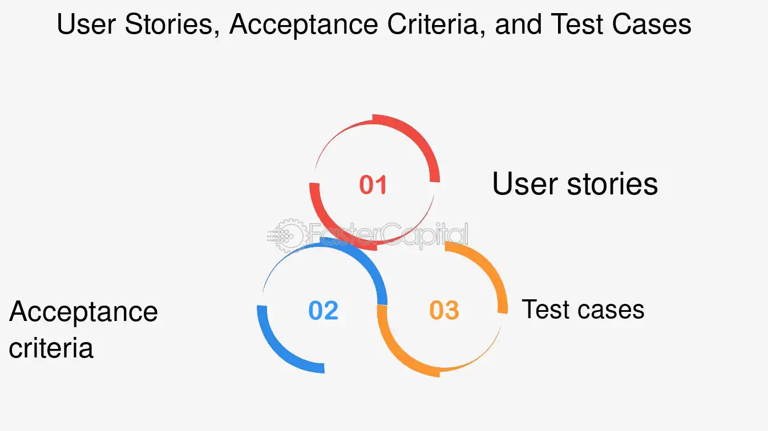
WORK METHODOLOGY
Ticket Workflow

Slide 30

Work methodology
Collaboration and Communication
Testing strategy (Unit Tests and End-to-End tests)

Slide 31
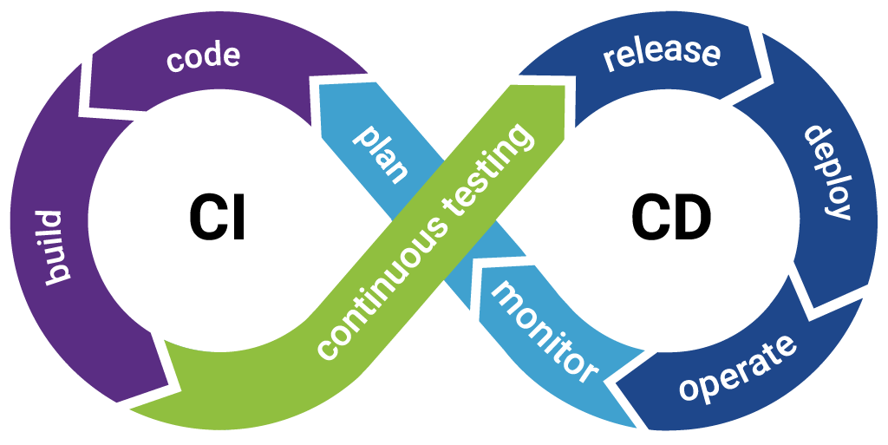
Work methodology
Continuos Integration / Continuos Deployment

Slide 32

Definition of ready
The user story is clearly defined and understood by the team.
Acceptance criteria are specified.
All dependencies are identified and addressed.
Any necessary designs or prototypes are available.
The story is small enough to be completed within a sprint (well-groomed and estimated).
The team has enough information to start and finish the development.
Stakeholders have approved the user story if necessary.
Test cases are done

Slide 33
Definition of done
Code is written, tested, and peer reviewed.
Unit tests are written and passed (at least 1 per ticket).
The code is tested by QA on the staging environment.
The feature passes all acceptance criteria.
Everything works without errors, and it is deployed to the production environment.

Slide 34

Conclusion

